Slide 1

Object & Class Diagram

Slide 2
Objects:
  a concept, abstraction, or thing with identity that has meaning for an application.
  often appear as proper nouns or specific references in problem descriptions
  All objects have identity and are distinguishable
  the choice of objects depends on judgment and the nature of problem
Classes:
  Describes a group of objects with the same properties (attributes), behavior (operations), kinds of relationships and semantics.
  Often appear as common nouns and noun phrases in problem description.
  Objects in a class have the same attributes and forms of behavior
    Difference in attribute values and specific relationship to other objects
  The choice of classes depends on the nature and scope of an application and is matter of judgment
  The interpretation of semantics depends on the purpose of each application and is a matter of judgment.

Slide 3
Class Diagram
The class model captures the static view of an system
  by characterizing the objects in the system
  the relationship between the objects
  and the attributes and operations for each class of objects

Slide 4
Class Diagram
The class diagram is the main building block of object oriented modeling.
used for
  general conceptual modeling of the systematics of the application
  detailed modeling translating the models into programming code.
Class diagrams can also be used for data modeling

Slide 5
Class Diagram
describes the attributes and operations of a class and also the constraints imposed on the system.
widely used in the modeling of object oriented systems
  can be mapped directly with object oriented languages
  widely used at the time of construction.

Slide 6
Object Diagram
JoeSmith:Person
MaySharp:Person
:Person
Objects
An object diagram shows individual objects and their relationships
Helpful for documenting test cases
A class diagram corresponds to an infinite set of object diagrams.

Slide 7
Class and Objects
Person
Class
JoeSmith:Person
MaySharp:Person
:Person
Objects
Fig: Objects and Classes are the focus of class modeling

Slide 8
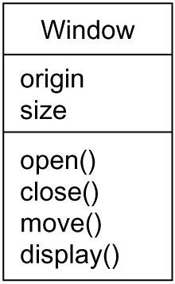
Class Diagram
Class Name
Attributes
Operations

Slide 9
Class and Object
First, there is the division of class and object.
  A class is an abstraction;
  an object is one concrete manifestation of that abstraction.
In the UML, you can model classes as well as objects, as shown in following Figures

Slide 10

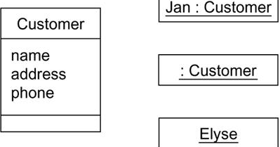
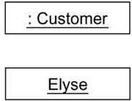
Class and Object

Slide 11
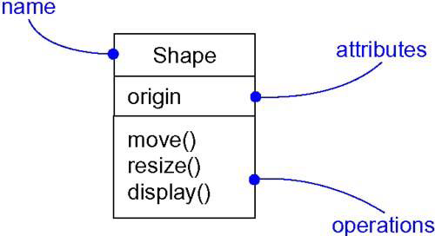
Class Diagram

Slide 12
“Order System”
First of all Order and Customer are identified as the two elements of the system and they have a one to many relationship because a customer can have multiple orders.
We would keep Order class is an abstract class and it has two concrete classes (inheritance relationship) SpecialOrder and NormalOrder.
The two inherited classes have all the properties as the Order class. In addition they have additional functions like dispatch () and receive ().

Slide 13
Class Diagram for Order System

Slide 14
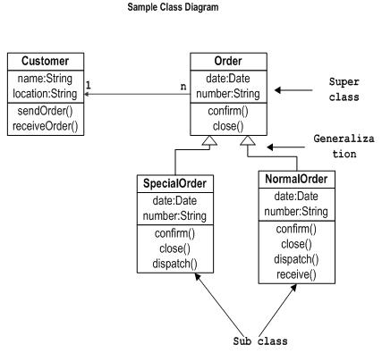

Slide 15

Relationships among Classes
Links
  the basic relationship among objects
  a tuple i.e. the list of objects
  an instance of an association
Association
  represents a family of links with common structure and semantics.
  Links of an association connect objects from same classes.
  Describes a set of potential links
  Binary associations (with two ends) are normally represented as a line.
Fig: Class diagram example of association between two classes

Slide 16
Notation
Link
  line between objects
  If the link has name, it is underlined
Association
  Line between related classes
  Association name is optional, if unambiguous
    Ambiguity arise when a model has multiple associations among the same classes
  Bidirectional
    Can be traversed in either direction and equally meaningful

Slide 17
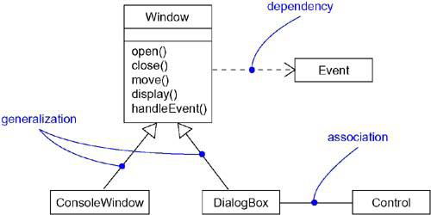
Class Diagram

Slide 18
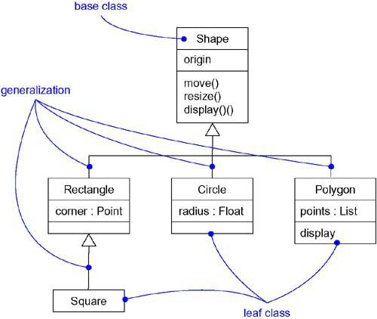
Class Diagram: Generalization

Slide 19
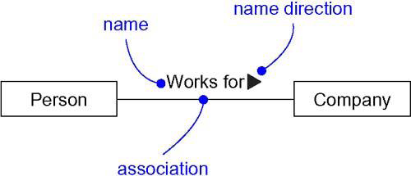
Class Diagram: Association Names

Slide 20
Multiplicity
  Multiplicity specifies the number of instances of one class that may relate to a single instance of an associated class.
  Multiplicity constrains the number of related objects.
  a subset of nonnegative integers.

Slide 21
Multiplicity
UML specifies multiplicity with an interval, such as..
0..1 →No instances, or one instance (optional, may)
1 →Exactly one instance
0..* or * → Zero or more instances
1..* → One or more instances (at least one)
3..5 → three to five inclusive

Slide 22
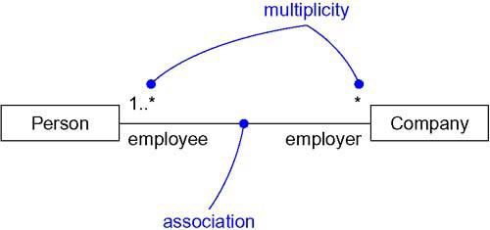
Class Diagram: Multiplicity

Slide 23
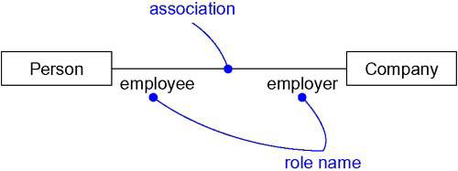
Class Diagram: Roles

Slide 24
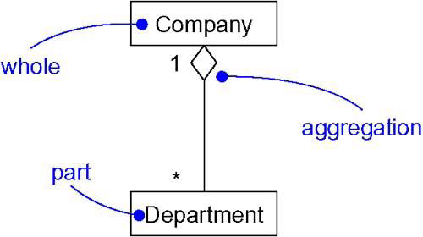
Class Diagram: Aggregation

Slide 25
Visibility in UML
To specify the visibility of a class member (i.e., any attribute or method) these are the following notations that must be placed before the member's name:
"+" Public
"-" Private
"#" Protected
"/" Derived (can be combined with one of the
others)
“~" Static

Slide 26
Association Types
Aggregation
  a variant of the "has a" association relationship;
  aggregation is more specific than association
  It is an association that represents a part-whole or part-of relationship.
  can occur when a class is a collection or container of other classes, but where the contained classes do not have a strong life cycle dependency on the container
  if the container is destroyed, its contents are not.

